Slide 1
Harmonization Package
Zheng Ren, Haochang Shou, Russell(Taki) Shinohara
Penn Statistics in Imaging and Visualization Endeavor
Department of Biostatistics, Epidemiology, and Informatics

Slide 2
Harmonization Package
ComBatFamQC (Harmonization & Visualization)
Statistical Analysis & Harmonization Preparation
ComBat Shiny Visualization
Age Trajectory Visualization
Residual Generation
Command Line Interface (2)
Combatfam_CLI.R
post_CLI.R
Harmonization
Batch Effect Evaluation
Post-harmonization Downstream Analysis
GitHub:
https://github.com/Zheng206/ComBatFam_Pipeline/tree/main

Slide 3
Diagram
Stages
Scenarios
Outputs
ComBatFamQC
Harmonization/
Visualization
First-time Harmonization
Out of sample Harmonization
Post-harmonization Downstream Analysis
Age Trajectory Visualization
Harmonize using Saved ComBat Model
Harmonize toward Reference Dataset
Residual Datasets
Calculate from Saved Model
Refit Model to Adjust for Covariates
Original ComBat
ComBat-GAM
Harmonized dataset
Interactive batch effect visualization through shiny app
ComBat Family
Original ComBat
Longitudinal ComBat
ComBat-GAM
CovBat
Longitudinal ComBat
CovBat
Interactive age trend through shiny app
Customized residual datasets

Slide 4
Out of sample Harmonization
Harmonize using Saved ComBat Model
sample data
New data
Batch | ROI.1 | ROI.2
Batch 1
Batch 2
Batch 3
Batch 4
Batch 5
Batch | ROI.1 | ROI.2
Batch 1
Batch 2
Batch 3
Batch 6
Batch 7
existing combat model
predict
New Batch Level
(OLS/EB) → location/scale
Note
Works for original ComBat and ComBat-GAM, NOT longitudinal ComBat (random effect)

Slide 5
Out of sample Harmonization
New data: include sample data
Batch | ROI.1 | ROI.2
Reference
Reference
Reference
Reference
Reference
Harmonize toward Reference Dataset
sample data
Sample data
(untouched)
Batch | ROI.1 | ROI.2
Batch 1
Batch 2
Batch 3
Batch 4
Batch 5
Compile data
Batch | ROI.1 | ROI.2
Batch 1
Batch 2
Batch 3
Batch 6
Batch 7
New portion

Slide 6
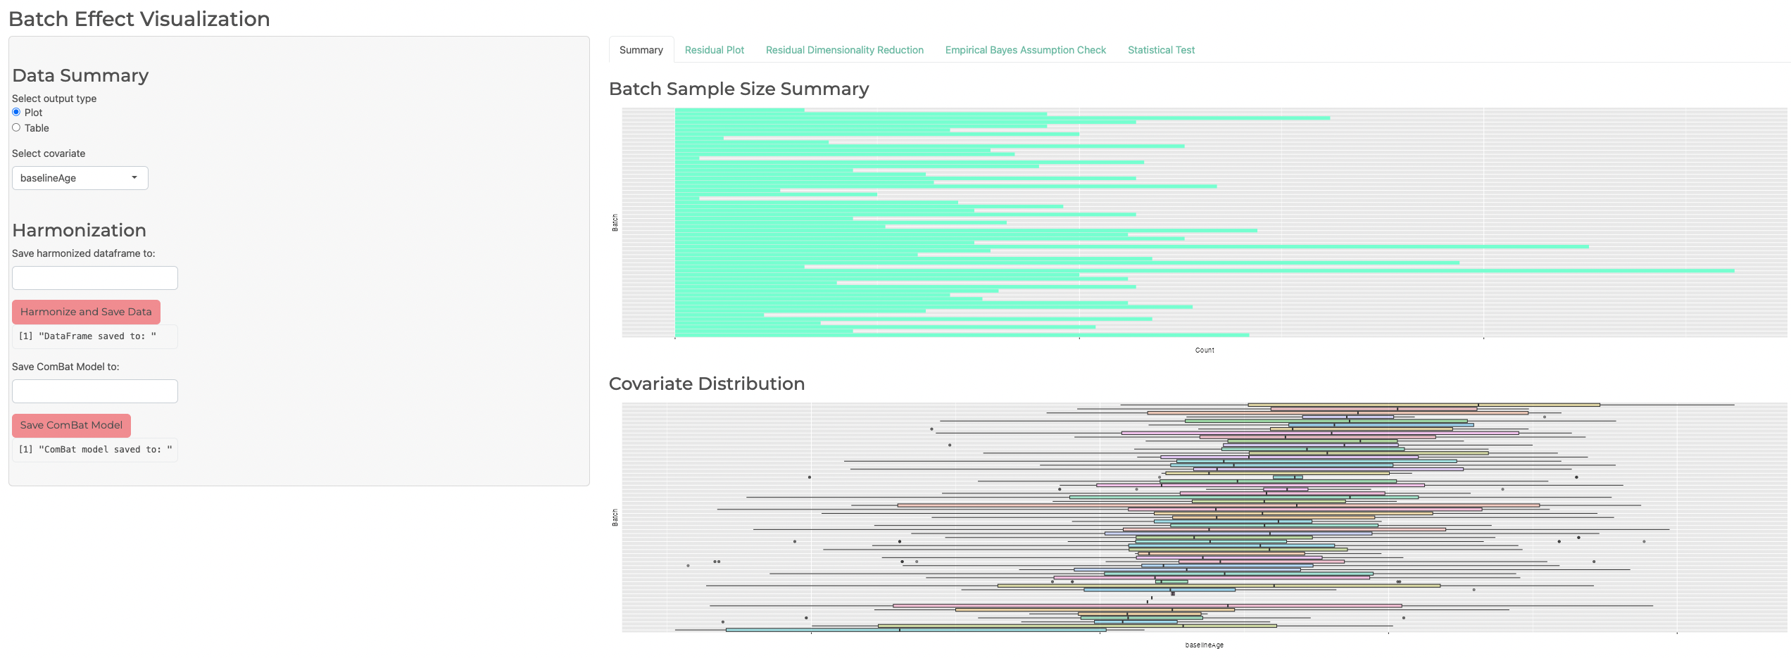
ComBat Shiny
Summay
Save Harmonized Dataset
Save Combat Model
Note: Can also save them through the command line.

Slide 7
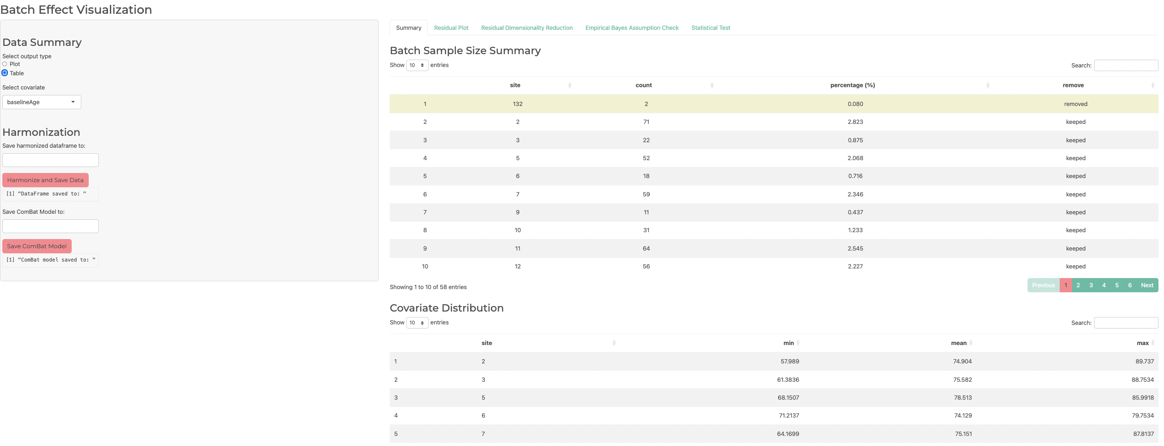
ComBat Shiny
Summay

Slide 8
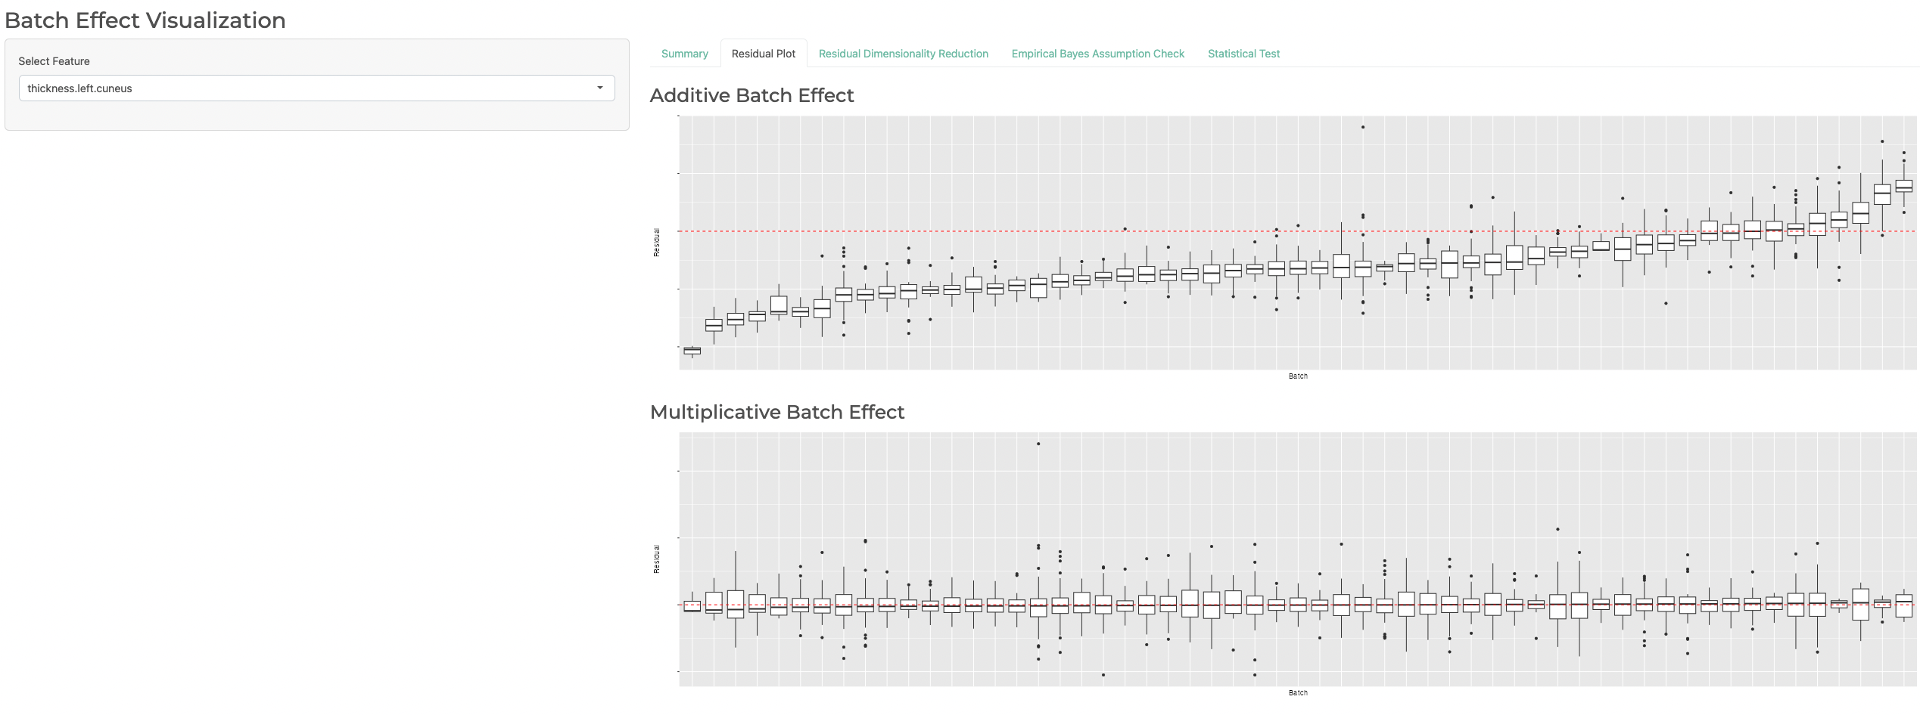
ComBat Shiny
Residual Plot

Slide 9
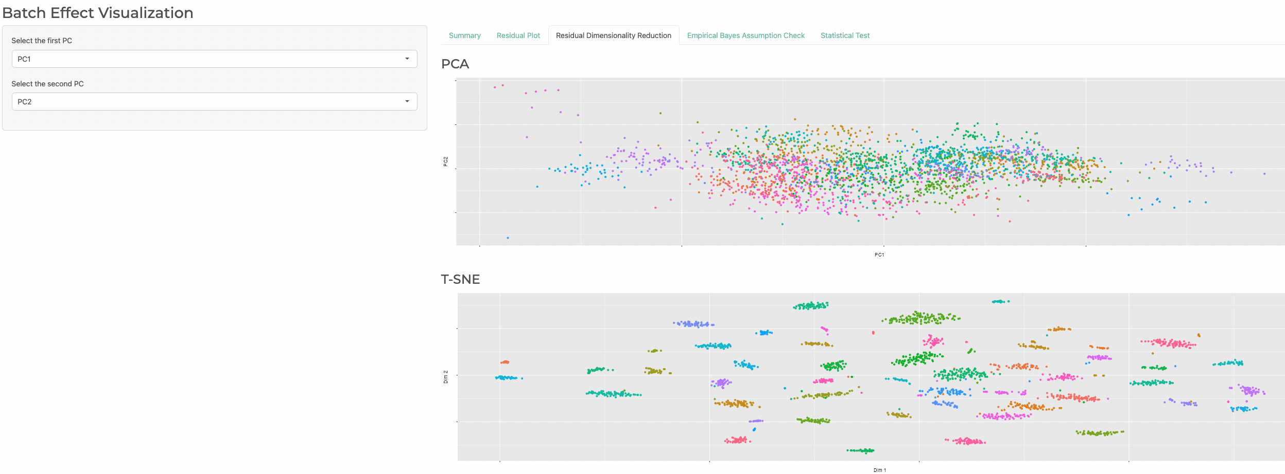
ComBat Shiny
Residual Dimensionality Reduction

Slide 10
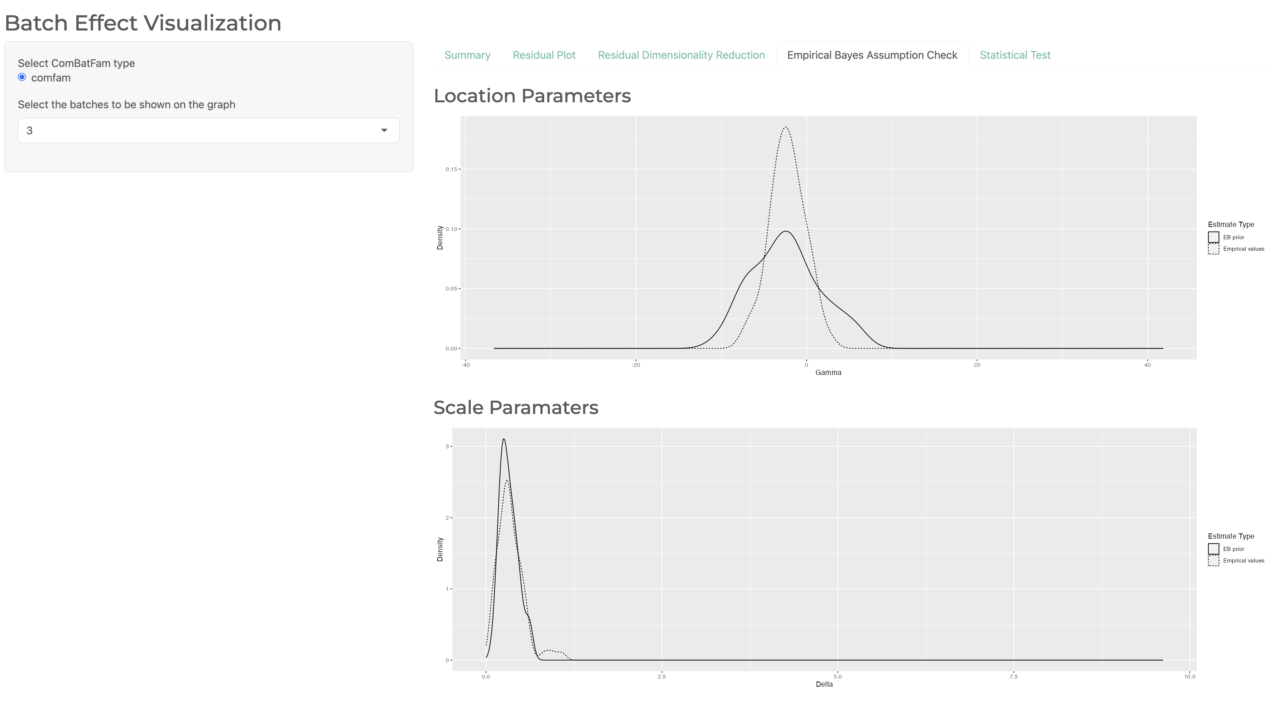
ComBat Shiny
Empirical Bayes Assumption Check

Slide 11
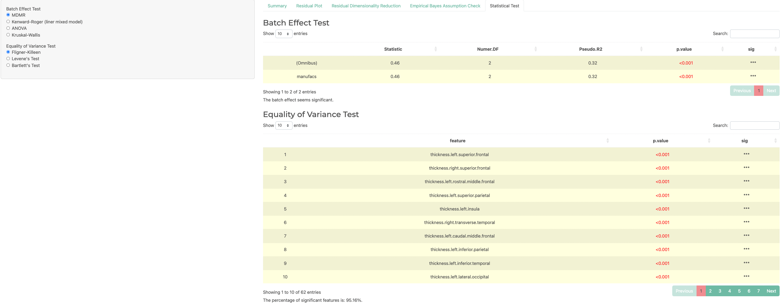
ComBat Shiny
Statistical Test
The Percentage of Significant Results

Slide 12
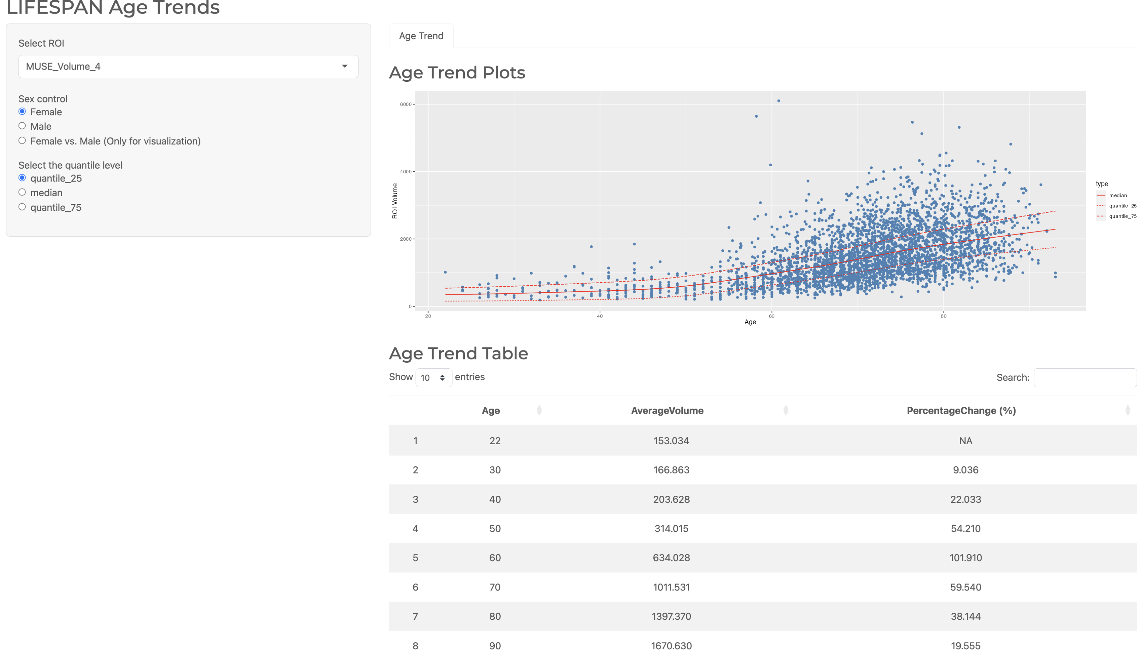
Age Shiny
Select the measurements to look at in the age trend table

Slide 13
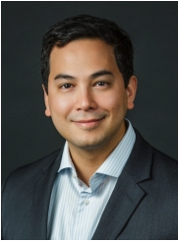

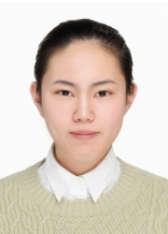
Personnel (PennSIVE)
Russell(Taki) Shinohara, PhD
Haochang Shou, PhD
Zheng Ren
Director
Professor of Biostatistics
Website
Associate Director
Associate Professor of Biostatistics
Website
Data Analyst

Slide 14
Reference
Fortin, J.-P., Cullen, N., Sheline, Y. I., Taylor, W. D., Aselcioglu, I., Cook, P. A., Adams, P., Cooper, C., Fava, M., McGrath, P. J., McInnis, M., Phillips, M. L., Trivedi, M. H., Weissman, M. M., & Shinohara, R. T. (2018). Harmonization of cortical thickness measurements across scanners and sites. NeuroImage, 167, 104–120. https://doi.org/10.1016/j.neuroimage.2017.11.024
Fortin, J.-P., Parker, D., Tunç, B., Watanabe, T., Elliott, M. A., Ruparel, K., Roalf, D. R., Satterthwaite, T. D., Gur, R. C., Gur, R. E., Schultz, R. T., Verma, R., & Shinohara, R. T. (2017). Harmonization of multi-site diffusion tensor imaging data. NeuroImage, 161, 149–170. https://doi.org/10.1016/j.neuroimage.2017.08.047
Johnson, W. E., Li, C., & Rabinovic, A. (2007). Adjusting batch effects in microarray expression data using empirical Bayes methods. Biostatistics, 8(1), 118–127. https://doi.org/10.1093/biostatistics/kxj037
Chen, A. A., Beer, J. C., Tustison, N. J., Cook, P. A., Shinohara, R. T., Shou, H., & Initiative, T. A. D. N. (2022). Mitigating site effects in covariance for machine learning in neuroimaging data. Human Brain Mapping, 43(4), 1179–1195. https://doi.org/10.1002/hbm.25688
Beer, J. C., Tustison, N. J., Cook, P. A., Davatzikos, C., Sheline, Y. I., Shinohara, R. T., & Linn, K. A. (2020). Longitudinal ComBat: A method for harmonizing longitudinal multi-scanner imaging data. NeuroImage, 220, 117129. https://doi.org/10.1016/j.neuroimage.2020.117129
Pomponio, R., Shou, H., Davatzikos, C., et al., (2020). "Harmonization of large MRI datasets for the analysis of brain imaging patterns throughout the lifespan." NeuroImage 208. https://doi.org/10.1016/j.neuroimage.2019.116450.

